Slide 1
Project Progress Review #4
(Implementation & Testing)
Project Title : Linguistic Analysis of Indo-European Languages
Project ID : PW19SMP003
Project Guide : Prof. Shreekanth M Prabhu
Project Team : Roshan U[01FB15ECS246],
Sanath Bhimsen[01FB15ECS260],
Mukesh M Karanth[01FB15ECS361].

Slide 2
Project Abstract and Scope
This project is a research oriented project which deals with
linguistic analysis of Indo-European Languages using Social
Network analysis.
We use data set that contains words from multiple languages to
perform similarity measures and centrality measures between
the words of different languages to find hidden links between
languages.
The scope of the project is subject to the project being a minor
project with time constraints, hence we are making use of
transliterated words, the number of words is limited to a max of
200 and we are using a select number of centrality and similarity measures.

Slide 3
Panel Modifications and Requirements
Panel Requirements:-
Use Phonetic Pronunciations of words instead of plain transliterated words.
Consider Nouns, Verbs and other relationship oriented words instead of prepositions, adjectives, etc.
Use Russian language instead of the Persian language.
Use a good data corpus of around 100+ words and 5+ languages.
Hyper-graph visualization of the words.

Slide 4
Project Testing and Implementation
Testing Methodologies:
Data set:
- Check the words in the dataset against the words in the google grammar for the language to validate it’s existence.
- Compare the phonetically translated word against its actual phonetic pronunciation to cross check the valid translation.
- Check for alternate forms of the same word.
Code Output:
- Check the output for multiple data sets.
- Perform analysis on different types of words and compare the results.
- Visual Inspection of outputs to verify the code.
- Compare the visual tree with the online sources to validate output.
- Validate the outputs observed using domain knowledge.

Slide 5
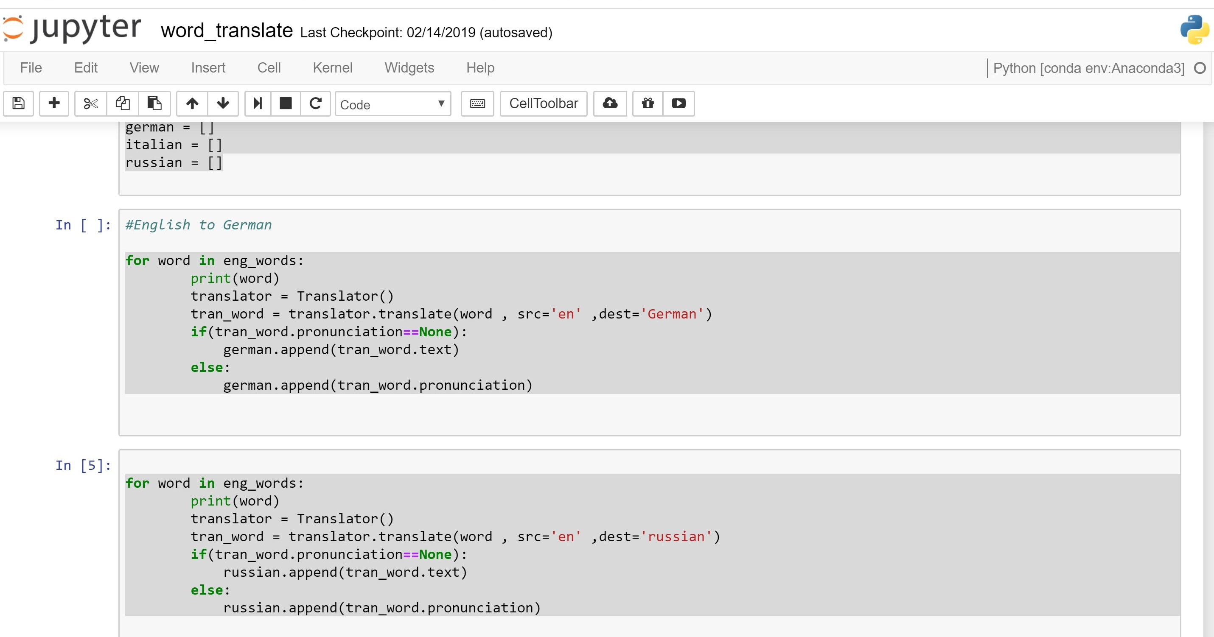
Implementation

Slide 6
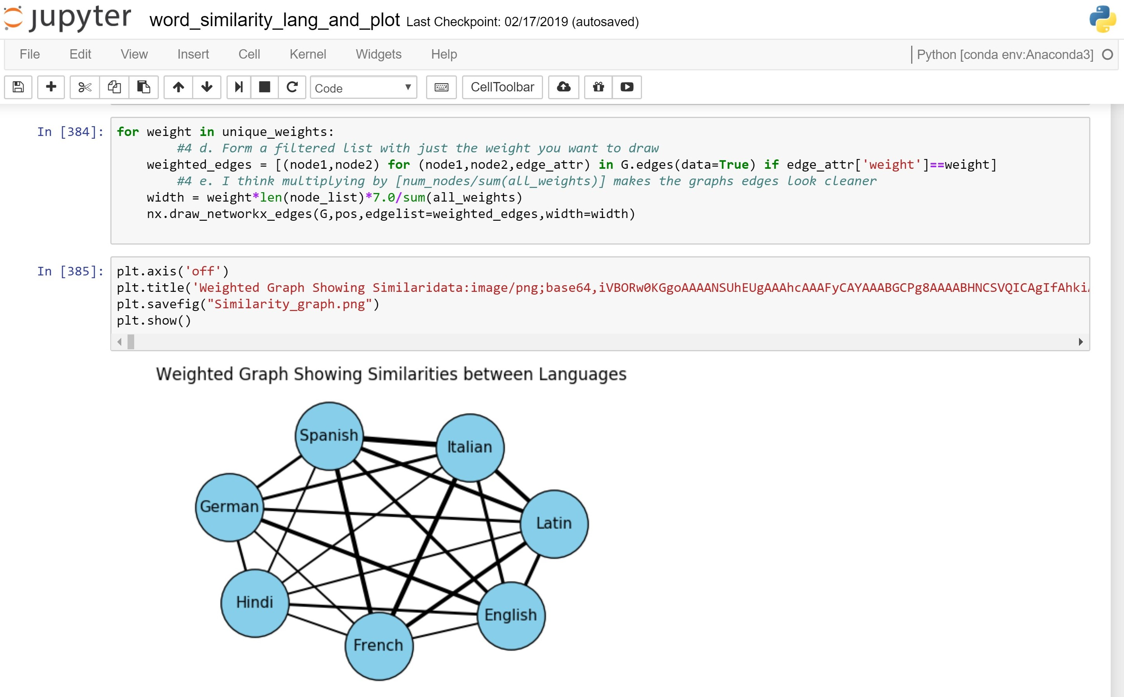

Slide 7
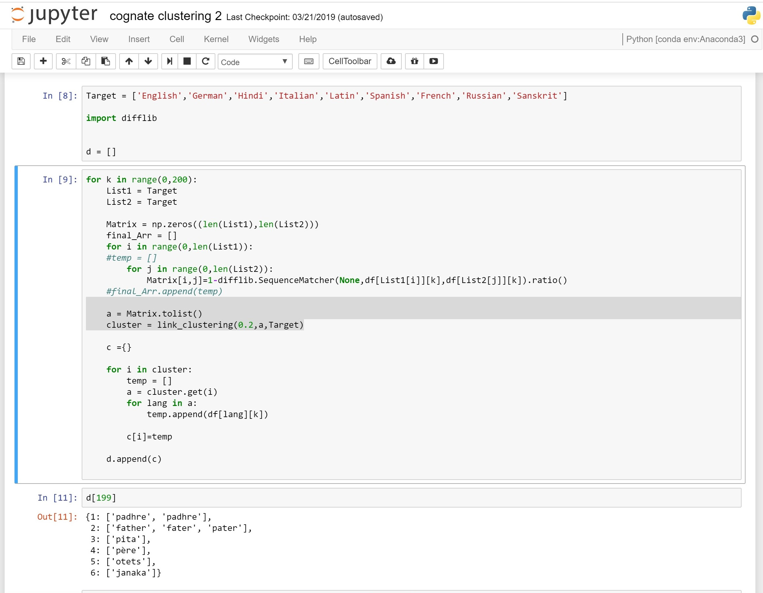

Slide 8
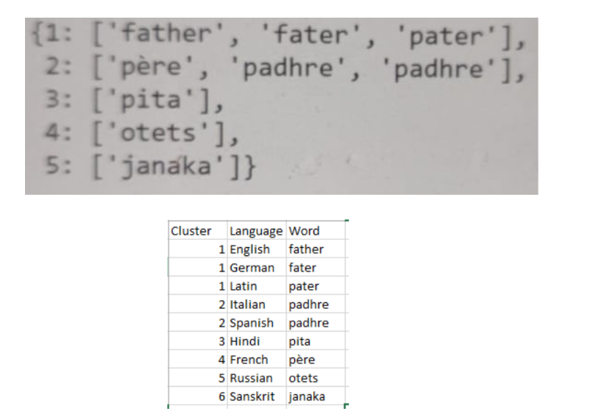

Slide 9
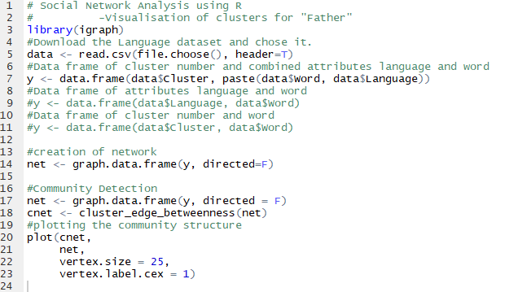

Slide 10
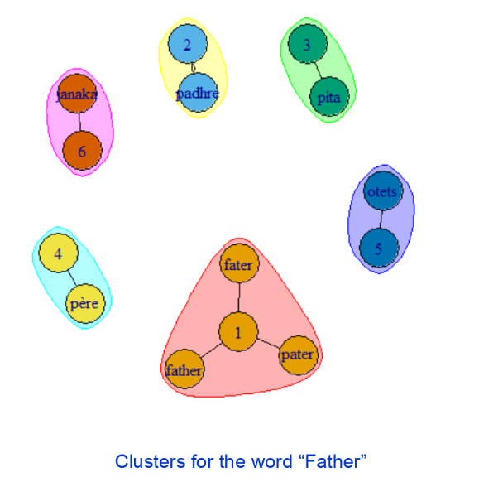

Slide 11
Project Progress So far
What is the project progress so far?
The Project is near completion and we have incorporated many of the panel requirements into the project.
We have appended 100 more words which are nouns and verbs specifically.
Performed Origin tree analysis on the words in the dataset.
Visualized the clustering of words in accordance to their similarities.
Status of documentation
CRS or equivalent for research projects: Completed
HLD/LLD or equivalent for research projects: Completed
Test Strategy / Test Plan documents: Pending
Final Project Report Status : Pending

Slide 12
Project Demo
Demo of the project:
Showing working of the project.
Showing Origin Tree visualization.
Data set creation needs will be demoed as usual.

Slide 13
Thank You

